Slide 1
Mid Project EpsilonAI
Name: Mohamed Hamdy Hassan
Project Name: Glaucoma Detection
Project Link: https://www.kaggle.com/datasets/teamincribo/glaucoma-detection-dataset

Slide 2
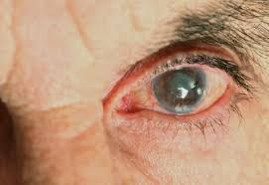
What is Glaucoma ?
a common eye condition where the optic nerve, which connects the eye to the brain, becomes damaged.

Slide 3
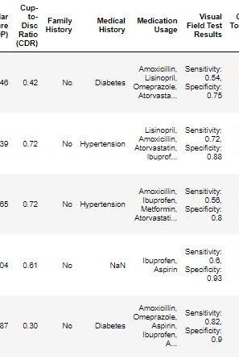
Purpose: A dataset containing all the required field to build AI/ML models to detect Glaucoma.
Description:
features:-
patient ID
Age
Gender (Male, Female)
Visual Acuity Measurements (0.0, 0.1, 0.3)
Intraocular Pressure (IOP) (Normal, Low, High)
Cup-to-Disc Ratio (CDR) (Normal, Case of Glaucoma)
Family History (Yes, No)
Medical History (Diabetes, Hypertension,
Glaucoma in family, Others)
Medication Usage
Visual Field Test Results (Sensitivity, Specificity)
Optical Coherence Tomography(OCT) Results
Pachymetry (Normal, Thick)
Cataract Status (Absent, Present)
Angle Closure Status (Opened, Closed)
Visual Symptoms
Diagnosis (Glaucoma, No Glaucoma)
Glaucoma Type

Slide 4
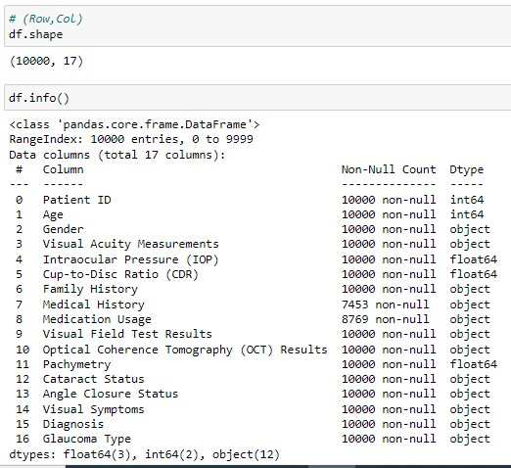
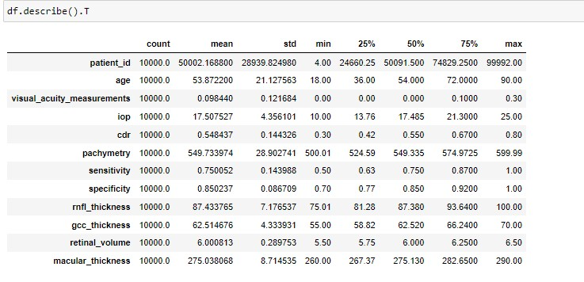
EDA (Exploratory Data Analysis): - Shape (10000,17), (10000,21) - Info - Statistics - Data Cleaning

Slide 5
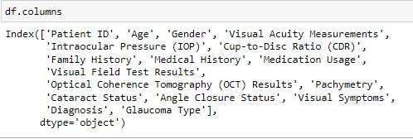
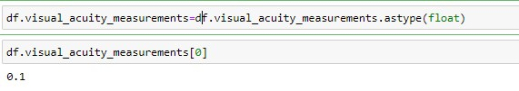
Data Cleaning: 1) Rename the columns. 2) Correction the datatype.

Slide 6

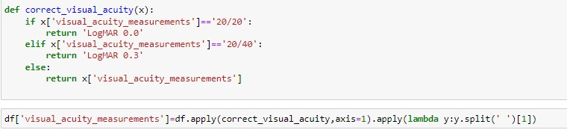
3) I standardized the measurements and changed their names according to the medical concepts.

Slide 7
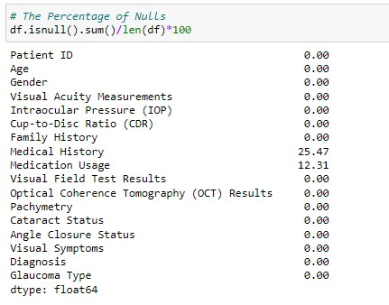
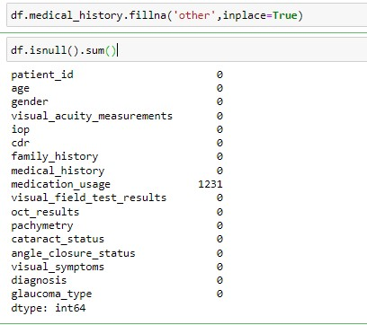
4) We have null-values in the medical history, Because there are other reasons that cause the disease, So we made a fillna for it with other.

Slide 8
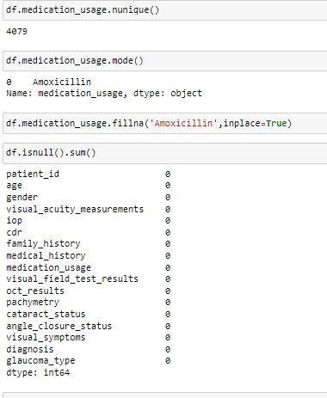
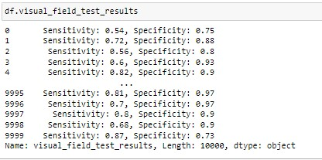
5) We have null-values in medical usage, So I found the most common medicine used for glaucoma patients from data via made and created fillna for this medicine. 6) I made an adjustment to the visual field test result, Which contains the sensitivity and specificity readings together, So I left each reading in a separate column, I made the same adjustment to the optical coherence tomography (OCT).

Slide 9
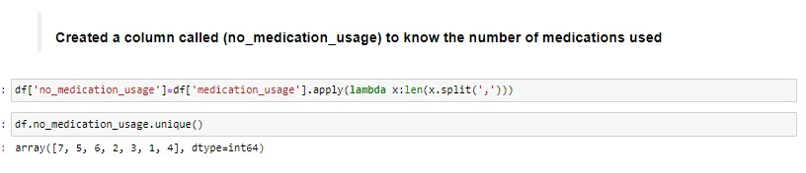
7) We created a new column that includes the number of medications that each patient takes in order to know whether one treatment condition is sufficient to treat the disease according to the diagnosis of the case, Or whether more than one treatment is required.

Slide 10
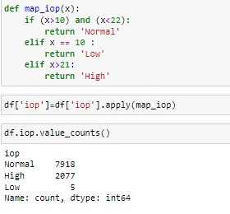
8) I changed IOP (Intraocular Pressure) column to categorical data in order to know whether he is has the disease or not, And I specified the ranges, And I made the same adjustment to the CDR(Cup-to-Disc Ratio) and pachymetry.

Slide 11
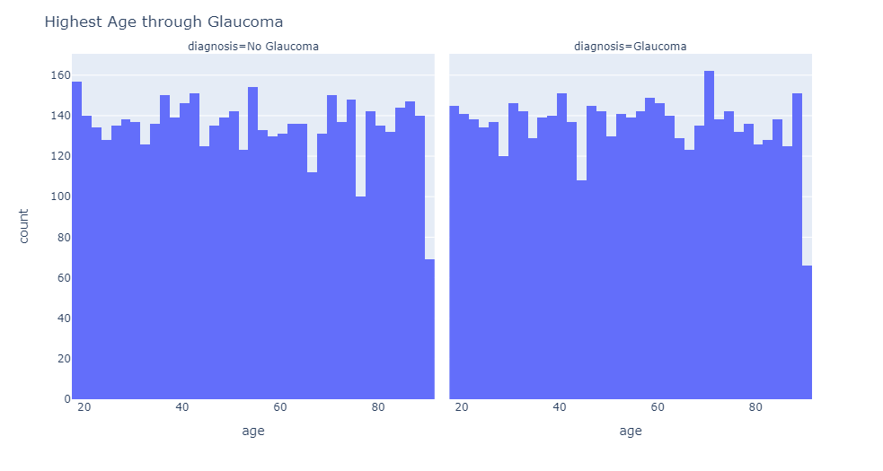
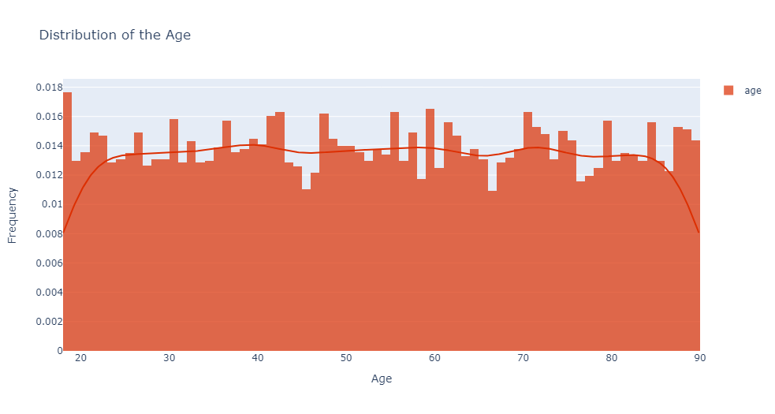
Data Analysis:
Questions:
The Highest Age that contains patients ?
The Highest Age Have Glaucoma ?

Slide 12
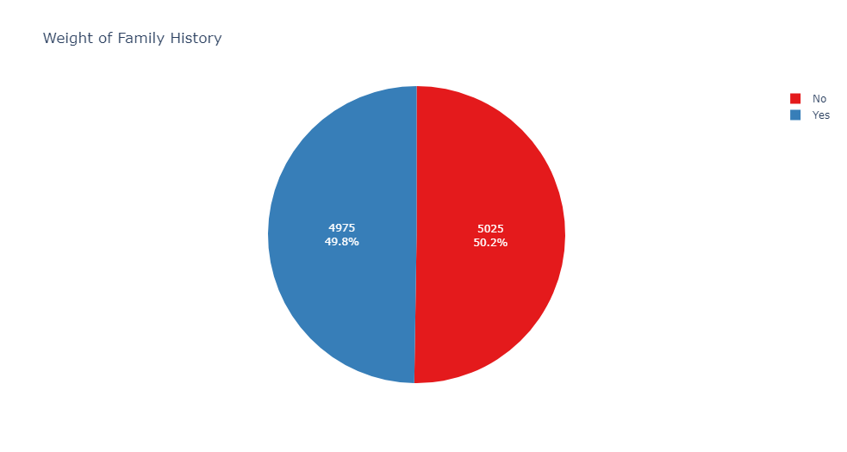
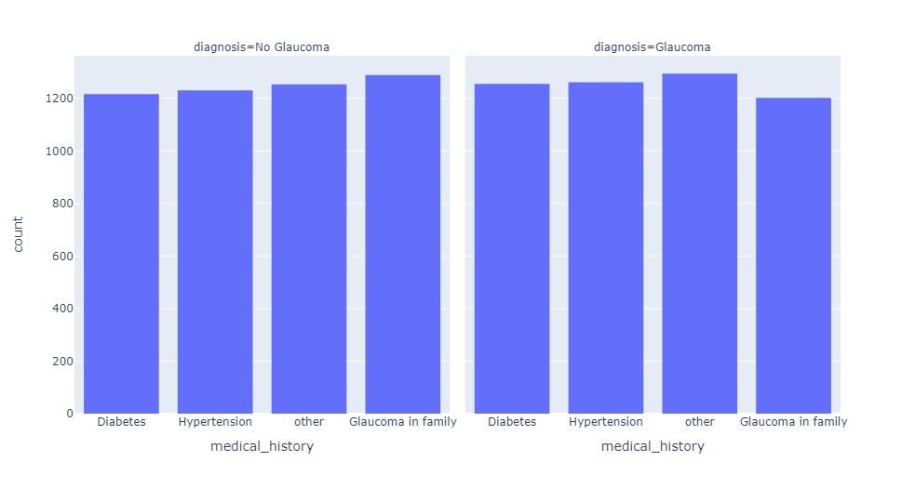
3) Is it a condition that I have a (family history) or (medical history) of glaucoma? - The Answer is NO

Slide 13
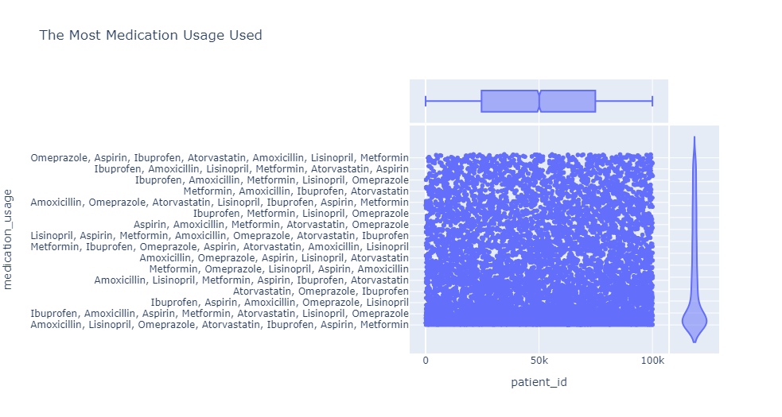
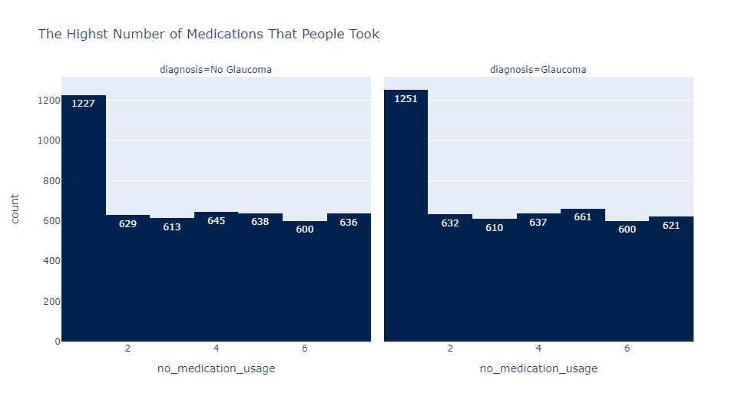
4) The most medications usage used. Note: The majority of patients take only one of these medications, and this is one of the reasons that increases the speed of the disease

Slide 14
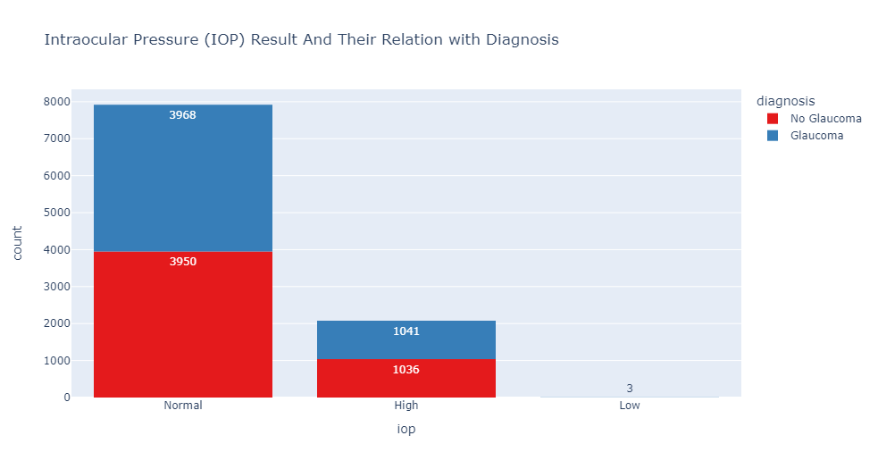
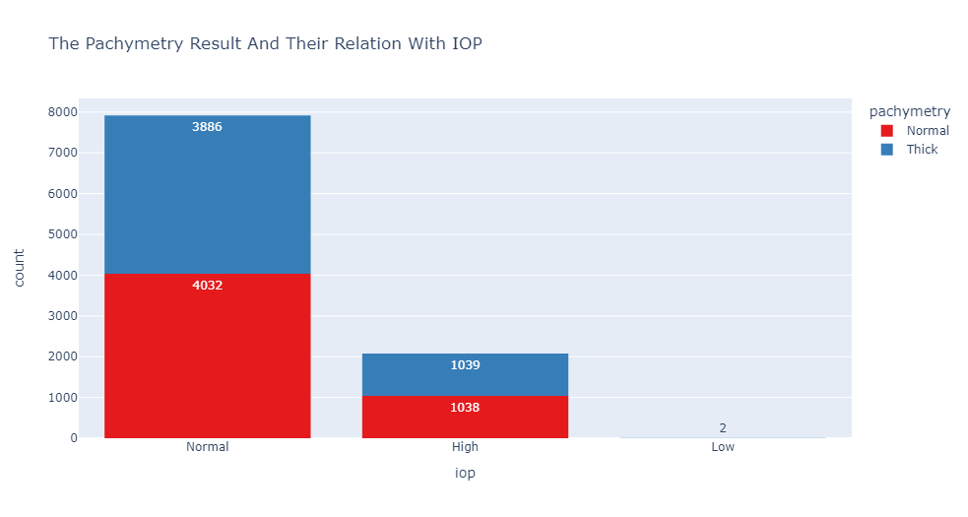
5) The Relation between IOP and Diagnosis ? & The Relation between IOP and Pachymetry ? Note: 1) 10<=IOP<=21 (Normal) 2) IOP<10 (Low) 3) IOP>21 (High)

Slide 15
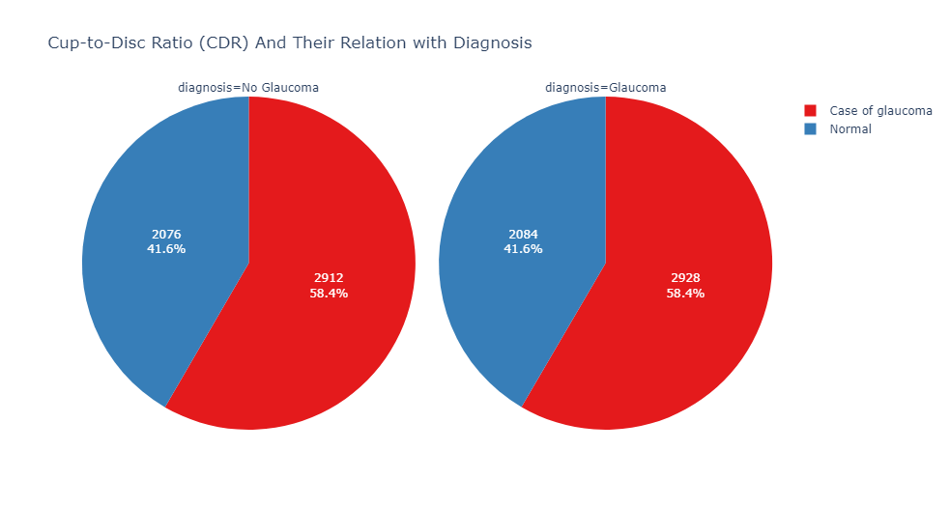
6) The weight of the Cup-to-Disc Ratio (CDR) (Case of Glaucoma, Normal), and the relation between CDR and Diagnosis. Note: 1) cdr <= 0.5 (Normal) 2) cdr > 0.5 (case of glaucoma)

Slide 16
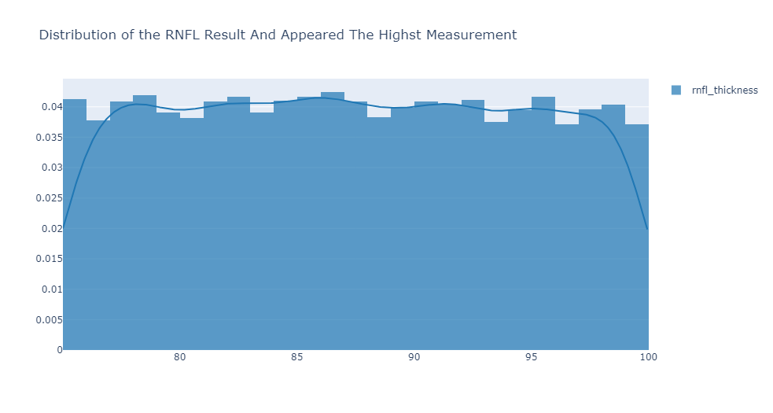
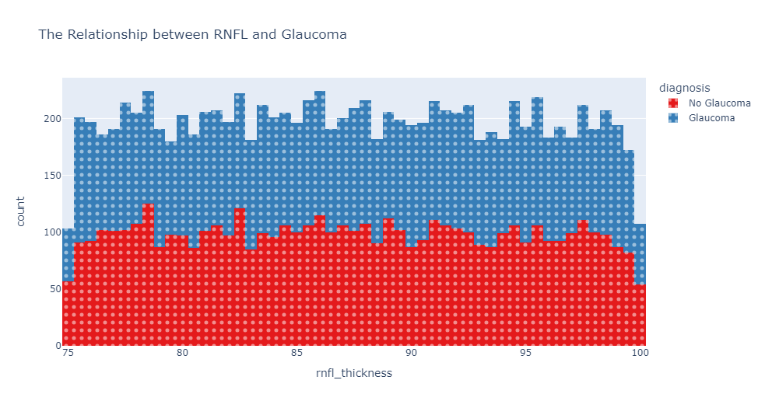
7) The Average of RNFL Result and what is the relationship between RNFL and Glaucoma ?

Slide 17
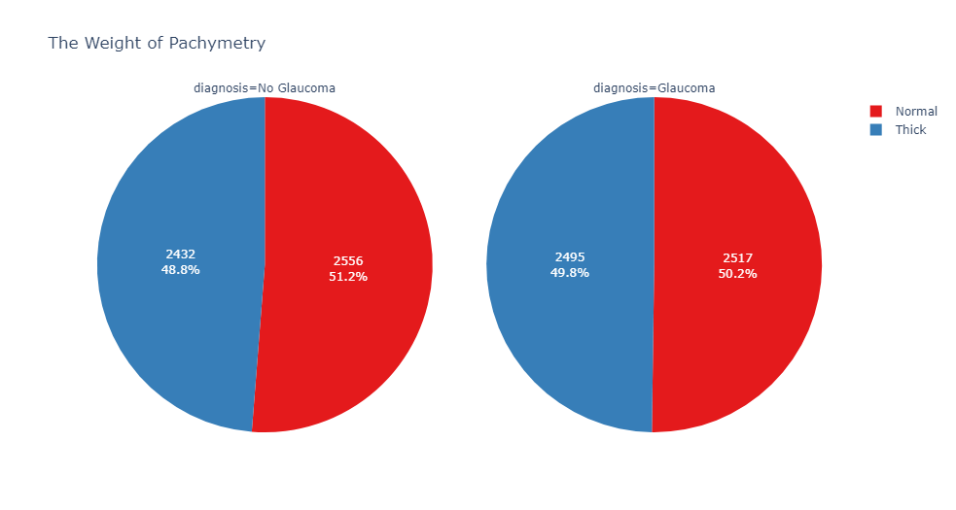
8) The Weight of Pachymetry and the Relationship between the Pachymetry and Diagnosis ? Note: 1) 500 <= pachymetry <=550 (Normal) 2) pachymetry > 550 (Thick)

Slide 18
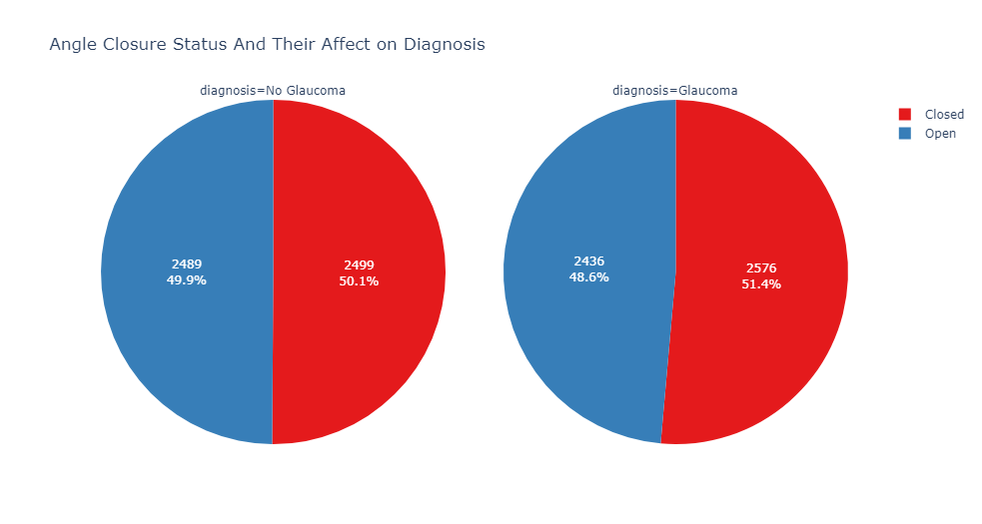
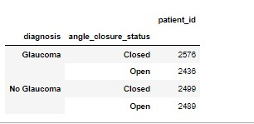
9) The weight of Angle closure status and How does angle closure affect on glaucoma?

Slide 19
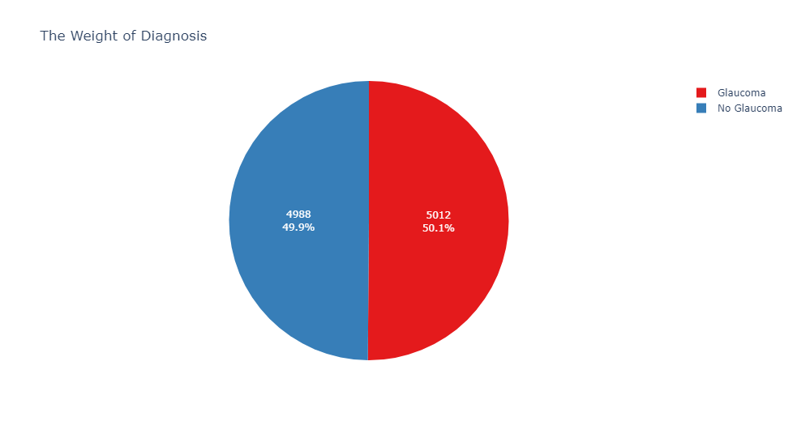
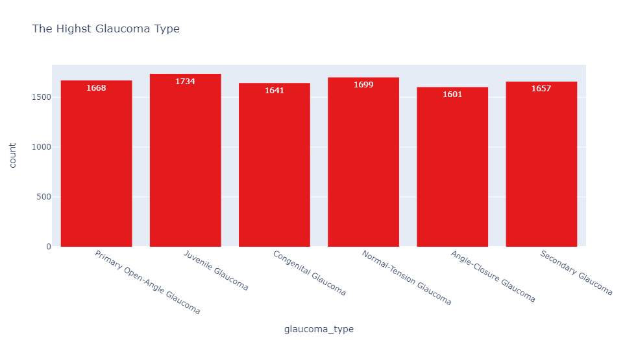
10)The Weight of Diagnosis and the Highest type of glaucoma ?

Slide 20
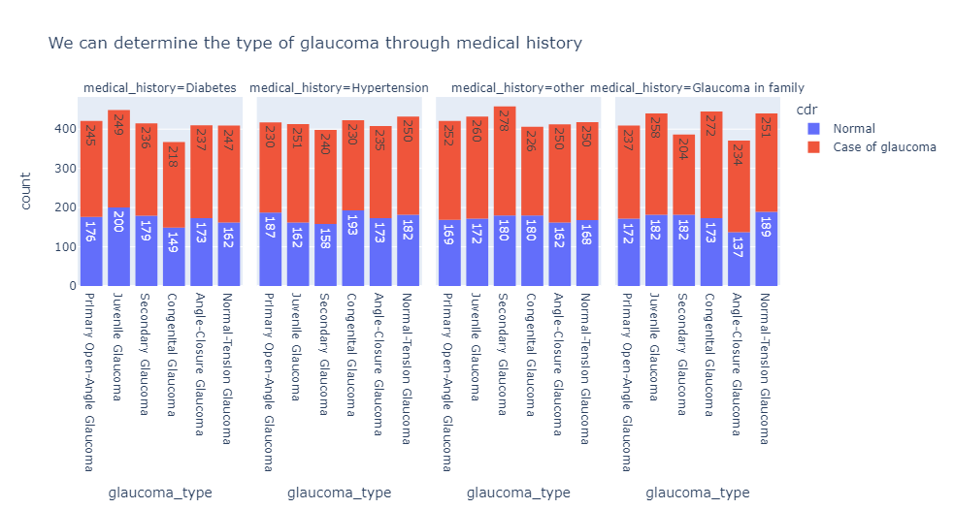
11) The Relation between Medical History and Type of Glaucoma.

